Slide 1
TSS 2.3 Data Integrity and Security
I can identify procedures to maintain data integrity and security (e.g. lock the screen, delete unrecognized emails, use trustworthy thumb drives, and use approved software)

Slide 2

passwords
Employ passwords that are hard to guess and easy to remember.

Slide 3
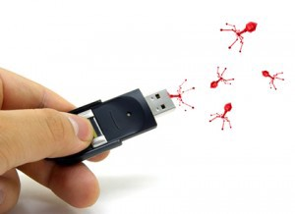
Road apples
In a road apple attack, a malware-infested storage device, such as a USB drive or DVD, is left in a location in which it is bound to be found by a member of an organization. They are being targeted. The bad guys use the human curiosity as the “hook.” The Department of Homeland Security learned how susceptible companies are to this simple attack. Staff members secretly dropped USB thumb drives in the parking lots of government buildings and private contractors. Of those who picked them up, 60% plugged them into office computers, curious to see what they contained. If the drive had an official logo, 90% were installed.
https://medium.com/@hacksoftwaredelhi/beware-of-the-road-apple-attack-54f7994ed6b0

Slide 4
The human domain
According to researchers, human error and failure to follow policy are the two most common causes of tech loss, accounting for roughly ¾ of all security incidents.
Always lock your computer when getting up for your work area, even if only for a minute.

Slide 5
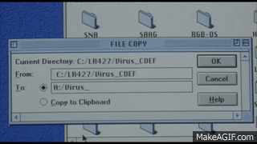
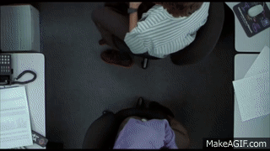
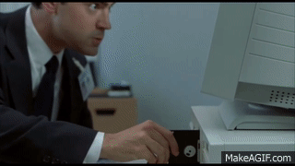
Trusted insiders
We have to accept the fact that many notable security breaches have occurred due to a trusted insider going bad. They may turn against the organization out of anger or a desire to get revenge for something they deemed unfair, or maybe they are being paid by some malicious outside organization. It doesn’t matter why. We must be aware that insiders are a threat and the reasons for going bad don’t matter.

Slide 6
The average attack
Did you know that the average cost of an attack originating from the outside of an organization is $57,000, while the average cost of damage incurred from an internal hack is an astounding $2,700,000?
According to the National Threat Assessment Center of the US Secret Service, in 70% of the cases studied, insiders exploited weaknesses in applications, processes and procedures to carry out their nefarious deeds.

Slide 7
Why do computers belonging to organizations like TUHSD, Google, intel, and others have administrator rights?
To ensure approved software gets installed
To ensure only software owned by the organization gets installed due to licensing rights
To ensure malware and other malicious software is not installed unknowingly

Slide 8
TSS 2.3 Data Integrity and Security
I can identify procedures to maintain data integrity and security (e.g. lock the screen, delete unrecognized emails, use trustworthy thumb drives, and use approved software)

